Slide 1
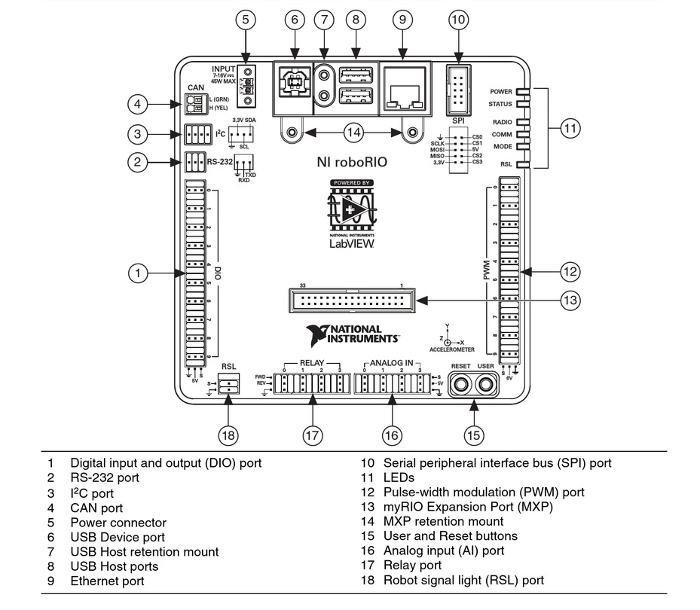

Slide 2
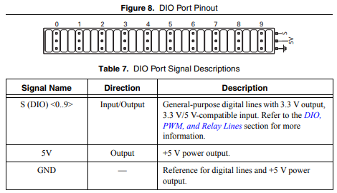
Digital Input / Output (DIO) Ports
DIO ports can be software configured to be Inputs or Outputs
Configured as Input:
Sense voltage on the S(DIO) pin and report a 0 or 1 to the code:
0.0 – 0.8V => 0
2.0 – 5.2V => 1
Open circuit will report as 1
Configured as Output:
Voltage is applied to the S(DIO) pin as written by the code
0.0 – 0.4V – max sinking current 4mA
2.4V – 3.5V – max sourcing current 4 mA

Slide 3
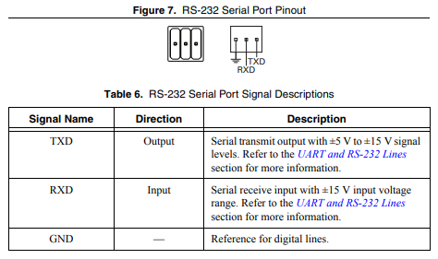
RS-232 Port
RS-232 is a serial communications protocol used to connect two digital devices.
First introduced in 1960
Relatively slow communication rate (115,200 bits/second)
Limited to point to point communication (two devices only)
TXD port (output) is connected to RXD (input) port on the other device (and vice versa)
Gnd connects to Gnd on other device
Used to communicate with a sensor or device that expects RS-232 communication.

Slide 4
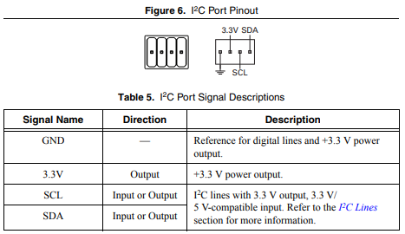
I²C Port
Inter-Integrated Circuit (I²C) serial communications port
Serial communications protocol that allows one primary module to communicate (send & receive) data to multiple secondary modules. Each secondary module has a unique ID and only receives and responds to messages addressed to that ID.
Moderate Communication Speeds: 400 kHz
SDA (Serial Data) pin is connected to SDA pin on all modules on network
SCL (Serial Clock) pin is connected to SCL pin on all modules on network
GND and 3.3V lines can be used to power other devices on network.
Used to communicate with a sensors or devices that expect I²C communication.

Slide 5
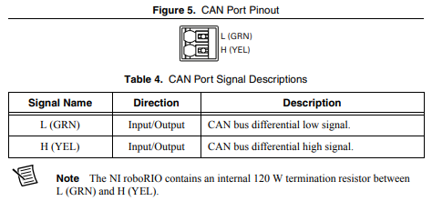
Controller Area Network (CAN) Port
Controller Area Network (CAN) serial communications port
Serial communications protocol that allows communication between modules. Multi-Master with automatic conflict resolution. Modules only receive messages addressed to them.
1Mbit/s data rates with high fault tolerance.
Module addressing assigned by First based on device type and manufacturer. If multiple devices of the same type and manufacturer are present on the bus, the device will have a selectable sequence number.
CAN L pin is connected to CAN L pin on all modules on network
CAN H pin is connected to CAN H pin on all modules on network
Wiring should be daisy chained module to module.
Used to communicate with a sensors or devices that expect CAN communication.

Slide 6
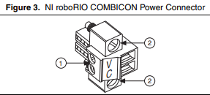
Power Connector
Power connector to power the RoboRIO device
V: +7 to 16 V
C: Ground (batt -)
Degradation with Voltage Drop:
>6.8V: Full normal Function
6.3 – 6.8V: 6V output rail voltage may droop
4.5 – 6.3V: Voltage output rails disabled
PWM outputs stop
CAN Motor Controllers disabled
Relay outputs low
All Normal Communication networks continue operation
Voltage must recover >7.5V to resume normal operation
<4.5V: Controller shuts down until voltage recovers above 4.65V

Slide 7
USB Device Port
Used to connect RoboRIO to a computer to deploy and debug code.
USB 2.0 Protocol

Slide 8
USB Host Ports
The NI roboRIO USB host port supports the following devices:
• Web cameras that conform to the USB Video Device Class (UVC) protocol.
• Machine vision cameras that conform to the USB3 Vision standard and are backward compatible with the USB 2.0 specification.
• Basler ace USB3 cameras.
• USB Flash drives.
• USB-to-IDE adapters formatted with FAT16 and FAT32 file systems.
LabVIEW usually maps USB devices to the /U, /V, /W, or /X drive, starting with the /U drive
if it is available.

Slide 9
Ethernet Port
Used to connect RoboRIO to a computer to deploy and debug code.
The first time you power up the chassis, it attempts to initiate a DHCP network connection. If
the chassis is unable to initiate a DHCP connection, it connects to the network with a link-local
IP address with the form 169.254.x.x.
Used in competition to establish communication with the driver station and field controller.
Typical method used by AdamBots to communicate with roboRIO

Slide 10
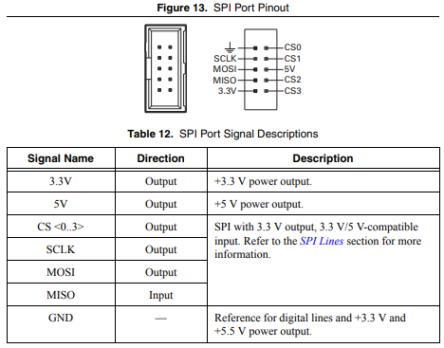
Serial Peripheral Interface (SPI) Port
High Speed short distance serial communication.
SCLK: Serial Clock (output from master)
MOSI: Master output – slave input
MISO: Master input – slave output
CS: Chip select (selects slave being communicated with (0, 1, 2, 3))
Used to communicate with a sensors or devices that expect SPI communication.

Slide 11
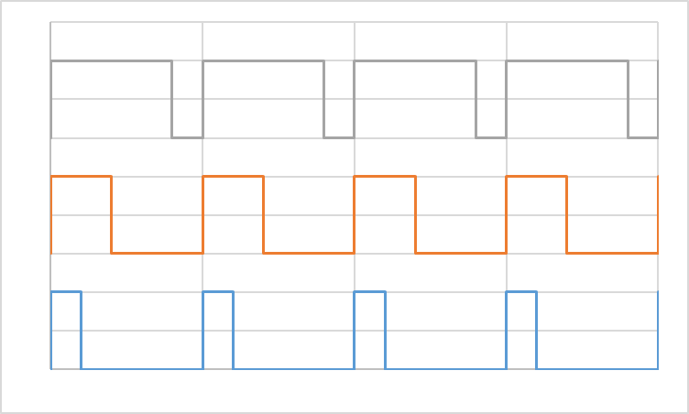
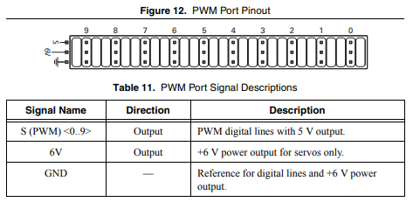
Pulse Width Modulation (PWM) Ports
Pulse Width Modulation communicates a variable signal by varying the ON time of a square wave from 0% to 100%
Low Voltage: 0 - 0.25V
High Voltage: 4.75 – 5.25V
Frequency: up to 150 kHz
Uses:
Intelligent output devices can sense PWM % and change their output based on the %
Remote Control servos use PWM to control output position
Motor Controllers can control voltage applied to the motor based on PWM
A LED’s brightness will appear to change based on the ON time
6V Line: output power for servos
Ground: reference ground for PWM and ground for servos
80% PWM
40% PWM
20% PWM

Slide 12
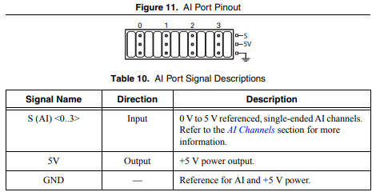
Analog Input Ports
RoboRIO senses voltage applied to the S terminal and returns a 12 bit binary number to the software (0 to 4095 decimal) based on the voltage measured.
Reading is based on the voltage applied to the S port relative to the GND and 5V lines.
S = GND => 0
S = 5V => 4095
S = (AI – Gnd) * 4095
(5V – Gnd)
Because the value returned is referenced off the 0V and 5V lines, those lines should be used to power whatever sensor is returning the analog value. If the 0V or 5V lines vary, it will not affect the analog reading. If the sensor is powered from a different source, if that source voltage varies it will affect the analog reading.
It is possible to read a digital sensor with an analog port, you’ll just see values near 0 when the digital line is low and values near 4095 when the digital line is high. (only really useful if you are out of Digital Input ports and need more)

Slide 13
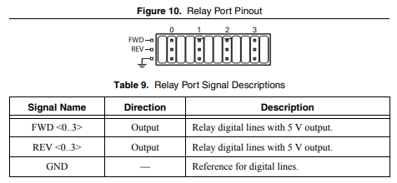
Relay Ports
Ports designed to control relays.
When ON, 4.75-5.25V applied to FWD or REV port
Can source up to 7.5 mA

Slide 14
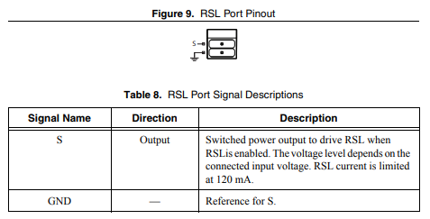
Robot Signal Light (RSL)
Connect to Robot Signal Light to indicate robot status.
S port is connected to main power feed when RSL is ON.

Slide 15
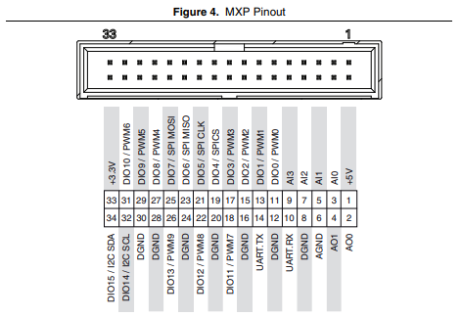
MXP Port
Connector to plug in ‘add on’ devices.
Contains:
+5V line to power add on device
+3.3V line to power add on device
GND ground for add on device
Analog Inputs: additional analog inputs
Analog Outputs: output pins who’s voltage can be varied by software
Digital I/O: Pins that can be configured as Digital Inputs or Outputs
PWM: Pins that can be configured as PWM outputs
UART.RX & TX Universal Asynchronous Receiver/Transmitter (digital comm)
SPI Additional SPI Pins

Slide 16
Controllers 101

Slide 17

Mechanical Closed Loop Controller: A Flyball Governor
Flyball shaft is connected to the output of the steam engine. As the steam engine and flyball shaft spins faster, the balls move outward due to centrifugal force. As they move outwards they pull the bottom piece upward which closes down the steam inlet valve.
Machine running too fast: balls move out and close down the steam inlet valve which slows machine down.
Machine running too slow: balls fall down due to gravity and open the steam inlet valve which allows machine to speed up.
Input: Plant: Output:
Steam Engine RPM Steam Engine Steam Inlet Valve
Controller:
1) measures the output
2) detects an error in the output
3) changes the input in a way that reduces the error
4) repeat....

Slide 18
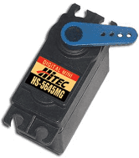
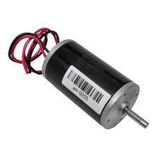
What is a Plant? It is whatever thing who’s output you are trying to control.
Plant
Input
Output
PWM
Position
Motor Voltage
Drivetrain
Robot
Turn Angle
+
+

Slide 19
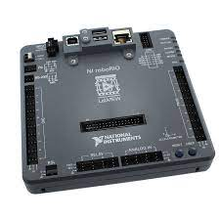
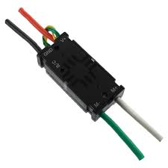
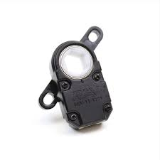
Closed Loop vs. Open Loop Control
The ‘Plant’
Open Loop
Software Controller
Block
Actual RPM
Desired RPM
PWM Command
When to use:
Suitable for systems that are very consistent in their response or where accuracy is not critical. (or there is no way to measure the output)
- Motor running a fan to blow air
- Controlling the brightness of a light
The ‘Plant’
Closed Loop
-
Software Controller
Block
Actual RPM
Desired RPM
+
RPM Error
PWM Command
Actual RPM
When to use:
Suitable for systems that are not always consistent or where accuracy is critical.
- Controlling the speed of the robot drivetrain
- Controlling the speed of a ball launcher
- Controlling how far the robot turns during autonomous
- Controlling something where the load on it varies (ie, driving with no cargo on board vs. fully loaded with cargo)

Slide 20
Closed Loop Software Controller
Example: Controlling the output speed of a motor
Software Controller
- Receives desired RPM for motor from software code or Drive Team input.
- Receives the actual RPM of the motor
- Calculates the error in motor RPM
RPM Error = actual RPM – desired RPM
- Calculates a new control signal to send to motor to reduce the error
- Repeat
The ‘Plant’
-
Software Controller
Block
Actual RPM
Desired RPM
+
RPM Error
PWM Command
Actual RPM

Slide 21
Proportional Integral Derivative (PID) Controller
A PID controller uses 3 things to calculate a new output command:
Proportional Command = Error * P Gain (Kp)
Integral Command = Accumulated Error * I Gain (Ki)
Derivative Command = (Change in error from last cycle / time from last cycle) * D Gain (Kd)
Output Command = P Command + I Command + D Command
Note: The command is solely based on the ERROR, not the Desired Value. The PID controller is always trying to drive the error to 0.
The ‘Plant’
-
Software Controller
Block
Actual RPM
Desired RPM
+
RPM Error
PWM Command
Actual RPM

Slide 22
Proportional Integral Derivative (PID) Controller
Proportional Command:
Proportional Command = Error * P Gain (Kp)
The bigger the error, the bigger the output command.
If there is no error, the output command is zero.
Does nothing to stabilize the system, just always pushes towards zero error.
The ‘Plant’
-
Software Controller
Block
Actual RPM
Desired RPM
+
RPM Error
PWM Command
Actual RPM

Slide 23
Proportional Integral Derivative (PID) Controller
Integral Command:
Integral Command = Accumulated Error * I Gain (Ki)
On the first software cycle, set the Accumulated Error equal to the Current Error.
On each subsequent software cycle, add the Current Error into the Accumulated Error.
So if the system settles at some RPM where the P command does not achieve the desired output and you are running at a constant error, the Accumulated Error will keep growing and the Integral Command will increase until the system achieves the desired output.
Is used to correct systems that require an output command to maintain zero error at their setpoint.
The ‘Plant’
-
Software Controller
Block
Actual RPM
Desired RPM
+
RPM Error
PWM Command
Actual RPM

Slide 24
Proportional Integral Derivative (PID) Controller
Derivative Command:
Derivative Command = (Change in error from last cycle / time from last cycle) * D Gain (Kd)
Looks at the rate of change of the error, ie, how fast is the error growing or shrinking.
If the error is growing over time, the Derivative Command will increase and provide a larger output command.
If the error is shrinking over time, the Derivative Command will decrease and provide a smaller output command.
Serves to make the system more responsive to a suddenly growing error and stabilizes the system around a constant target value.
The ‘Plant’
-
Software Controller
Block
Actual RPM
Desired RPM
+
RPM Error
PWM Command
Actual RPM

Slide 25
General Notes
You don’t have to use all three gains. It is perfectly acceptable to have Kd or Ki set to zero (a P, PD, or PI controller) if it gives you the desired performance.
The controller is satisfactory when you get the system performance you are looking for.
The ‘Plant’ is part of the control loop, so if the plant changes (i.e., the friction or weight or ????) changes, then you’ll most likely have to retune the controller to the new plant charactistics. (example, high/low gear in drivetrain)
PID Controllers are just one type of software controller, there are many others (Sliding Mode, Linear Quadratic Regulator, etc.)
PID Controllers work best when the plant is relatively linear in its response. Meaning that it responds the same to control inputs over the full range of operation. If it is highly nonlinear, you have 4 options:
- Tune the PID so it works well in the area where will spend most time and accept degraded performance in the other areas
- Add a Feed Forward algorithm to compensate for the non-linearity (more later on this...)
- Make the gain factors a function of some value in the system (gain scheduling) to give different performance in different areas
- Select a different type of controller that is better able to deal with nonlinearities in the plant.
The ‘Plant’
-
Software Controller
Block
Actual RPM
Desired RPM
+
RPM Error
PWM Command
Actual RPM

